Slide 1
Databases, SQL and MS SQL Server
RDBMS, SQL Language, Joins, Aggregate Functions, Grouping, MS SQL Server
Mihail Stoynov
Materna Bulgaria
mihail.stoynov.com

Slide 2
Table of Contents
Introduction to MS SQL Server 2008 Express
Basic knowledge
Services
Types of databases
Authentication and permissions
SQL Server Management Studio Express
Moving a database
Through backups and restore
By detaching and attaching

Slide 3
Table of Contents (2)
Introduction to SQL
SQL and T-SQL Languages
The Telerik Academy Database Schema
Introducing the SELECT SQL Statement
Allowed Operators
The WHERE Clause
Sorting with ORDER BY
Selecting Data From Multiple Tables

Slide 4
Table of Contents (3)
Selecting Data From Multiple Tables
Natural Joins
Join with USING Clause
Inner Joins with ON Clause
Left, Right and Full Outer Joins
Cross Joins
Inserting Data
Updating Data
Deleting Data

Slide 5
Table of Contents (4)
Relational Databases - Fundamental concepts
Database models
Relational database models
RDBMS systems
Tables, relations, multiplicity, E/R diagrams
Normalization, Constraints, Indexes
The SQL language
Stored procedures, Views, Triggers
Transactions and isolation levels

Slide 6
Table of Contents (5)
Database Modeling
Modeling data – principles
Data types in SQL Server
Creating a new database SQL Server
Creating tables
Defining a primary key
Creating relations between the tables
Naming conventions

Slide 7
MS SQL Server 2008
Basic Knowledge

Slide 8
What is Microsoft SQL Server
Relational Database Management System – RDBMS
The main language that is supported is Transact SQL (T-SQL)
There is a free distribution
http://www.microsoft.com/express/database/
The most recent version is 2008
Works only on Windows systems

Slide 9
Services in SQL Server 2008
Sqlservr – database engine
Processes T-SQL queries
Distributes resources to the clients
Ensures database integrity
SQLServerAgent
Gets information for the processes' state
Creates schedules and automates managing of tasks
Can send email or other massage if a problem arises

Slide 10
Services in SQL Server 2008
Distributed Transaction Coordinator (MS DTC)
Permits client applications to include several different sources of data in one transaction
Coordinates committing the distributed transaction across all the servers that are enlisted in the transaction

Slide 11
SQL Server Databases

Slide 12
Types of Databases
System databases
Maintain information for MS SQL Server as a system
User databases
Databases created by a user
They use the system databases internally

Slide 13

Types of Databases
System Databases
master
model
tempdb
msdb
distribution
pubs
Northwind
User1
User Databases

Slide 14
SQL Server Databases
Each database consists of 2 files:
.mdf file – a file that contains all the data in the database
.ldf file – a file that keeps track of transactions, logs and so on
You need both of them to use the database

Slide 15
SQL Server Authentication

Slide 16
Connecting to SQL Server
We need to know
The name of the server
The name of the database
Username/password (if using SQL Server authentication)
Types of authentication in SQL Server
Windows (by using a Windows user credentials)
Mixed (both Windows and SQL Server)

Slide 17
SQL Server Users Permissions
Each user has certain permissions and roles for a database (Database User Account)
A role defines a group of users with the same permissions
There are 3 types of roles in MS SQL Server
Fixed server roles
Fixed database roles
User-defined database roles

Slide 18
SQL Server Management Studio
A Powerful Management Tool for Administrators and Developers

Slide 19
SQL Server Management Studio Express
SQL Server Management Studio Express (SSMSE) is a Microsoft graphical database management tool
Free
Easy to use
Works with SQL Server 2008 and SQL Server 2008 Express Edition
Free download from:
http://www.microsoft.com/downloads/details.aspx?FamilyID=08E52AC2-1D62-45F6-9A4A-4B76A8564A2B&displaylang=en

Slide 20
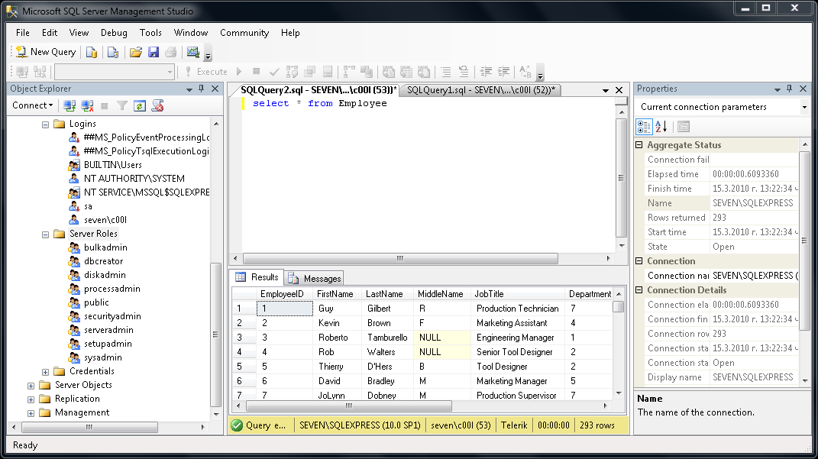
SQL Server Management Studio Express

Slide 21
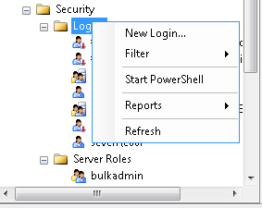
SSMSE Setting Server Account
You can use SSMSE to give permission to users
Follow these steps:
First select the security folder in Object Explorer and right click the Logins folder
Choose "New Login…"

Slide 22
SSMSE Setting Server Account (2)
In the following dialog click the search button
Select one of the windows account in a typical Windows fashion
Leave the authentication method set to Windows authentication
Click "OK"
In this way you create an SQL Server User account
Later you can set database permissions for this account

Slide 23
SSMSE Setting Database Account
Right click on the "Security" directory under some of the databases and choose "New" → "User"
Set the username you want and select one of the Server accounts to use
Set the roles for this user
Click "Ok" to confirm
By selecting the name_of_database → properties → permissions you can also set specific permissions for the accounts

Slide 24
SQL Server Management Studio Express
It can be used to visually change the structure or data in a database
It can execute T-SQL queries
Select the database you want to work with in the Object Explorer
Click the [New Query] button just under the file menu
Write the query in the window to the right of Object Explorer
Click the [Execute] button

Slide 25
Moving an SQL Server 2008 Database

Slide 26
Moving a Database
Necessary when we install a certain application at the customer environment
Ways of moving an SQL Server database:
By means of backup and restore
By detaching and attaching the database
The 2 servers must have the same versions!

Slide 27
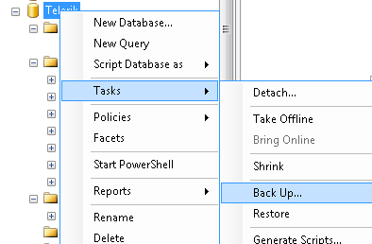
Moving by Backup and Restore
We back up the database through SQL Server 2005 Management Studio
Transport the backup to the receiving server

Slide 28
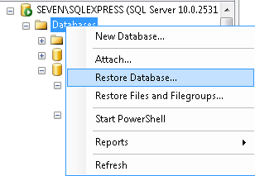
Moving by Backup and Restore
Again by using SQL Server 2005 Management Studio restore the database

Slide 29
Moving by Detaching and Attaching
On the source server:
Choose the database in SQL Server Management Studio
From the context menu we choose the Detach command
We copy the database files from the source server to the destination server. As mentioned files have the following extensions :
<database_name>.mdf

Slide 30
Moving by Detaching and Attaching (2)
< database_name_log>.ldf
We attach the database on the destination server with the Attach command in SQL Server Management Studio

Slide 31
Introduction to SQL
(with Microsoft SQL Server)

Slide 32
Relational Databases
Short Overview

Slide 33
Relational Databases
A relational database:
Can be accessed and modified by executing Structured Query Language (SQL) statements
Uses a set of operations to extract subset of the data
Contains a collection of tables
Relationships are defined between the tables
Notes:
Properties of a Relational Database
In a relational database, you do not specify the access route to the tables, and you do not need to know how the data is arranged physically.
To access the database, you execute a structured query language (SQL) statement, which is the American National Standards Institute (ANSI) standard language for operating relational databases. The language contains a large set of operators for partitioning and combining relations. The database can be modified by using the SQL statements.

Slide 34
Communicating with a DB
SQL statement is
entered
SQL statement is
sent to the database
SELECT Name
FROM Department
Database
Name
Engineering
Sales
Marketing
…
The result is returned
(usually as a table)
Notes:
Structured Query Language
Using SQL, you can communicate with the Oracle server. SQL has the following advantages:
Efficient
Easy to learn and use
Functionally complete (With SQL, you can define, retrieve, and manipulate data in the tables.)

Slide 35
SQL and T-SQL
Introduction

Slide 36
What is SQL?
Structured Query Language (SQL)
Declarative language for query and manipulation of relational data
SQL consists of:
Data Manipulation Language (DML)
SELECT, INSERT, UPDATE, DELETE
Data Definition Language (DDL)
CREATE, DROP, ALTER
GRANT, REVOKE

Slide 37
SQL – Examples
SELECT FirstName, LastName, JobTitle
FROM Employee
INSERT INTO Project(Name, StartDate)
VALUES('Introduction to SQL Course', '1/1/2006')
SELECT * FROM Project WHERE StartDate = '1/1/2006'
UPDATE Project
SET EndDate = '8/31/2006'
WHERE StartDate = '1/1/2006'
DELETE FROM Project
WHERE StartDate = '1/1/2006'

Slide 38
What is T-SQL?
T-SQL is an extension to the standard SQL language
The standard language in MS SQL Server database
Supports if statements, loops, exceptions
Like the high-level procedural programming languages
Used for writing procedures, functions, triggers, etc.

Slide 39
T-SQL – Example
CREATE PROCEDURE EmpDump AS
DECLARE @EmpId INT, @EmpFName NVARCHAR(100),
@EmpLName NVARCHAR(100)
DECLARE emps CURSOR FOR
SELECT EmployeeID, FirstName, LastName FROM Employee
OPEN emps
FETCH NEXT FROM emps INTO @EmpId, @EmpFName, @EmpLName
WHILE (@@FETCH_STATUS = 0) BEGIN
PRINT CAST(@EmpId AS VARCHAR(10)) + ' '
+ @EmpFName + ' ' + @EmpLName
FETCH NEXT FROM emps INTO @EmpId, @EmpFName, @EmpLName
END
CLOSE emps
DEALLOCATE emps
GO

Slide 40
The Telerik Academy Database Schema
E/R Diagram

Slide 41
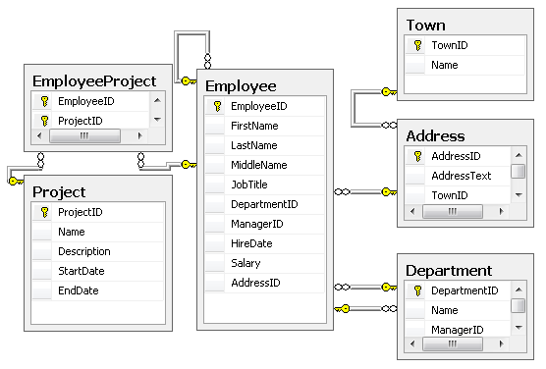
The Telerik Academy Database Schema in SQL Server

Slide 42
SQL Language
Introducing SELECT Statement

Slide 43
Capabilities of SQL SELECT
Projection
Take some of the columns
Selection
Take some of the rows
Table 1
Table 1
Join
Combine tables by
some column
Table 1
Table 2
Notes:
Capabilities of SQL SELECT Statements
A SELECT statement retrieves information from the database. Using a SELECT statement, you can do the following:
Projection: You can use the projection capability in SQL to choose the columns in a table that you want returned by your query. You can choose as few or as many columns of the table as you require.
Selection: You can use the selection capability in SQL to choose the rows in a table that you want returned by a query. You can use various criteria to restrict the rows that you see.
Joining: You can use the join capability in SQL to bring together data that is stored in different tables by creating a link between them. You learn more about joins in a later lesson.

Slide 44
Basic SELECT Statement
SELECT identifies what columns
FROM identifies which table
SELECT *|{[DISTINCT] column|expression [alias],...}
FROM table
Notes:
Basic SELECT Statement
In its simplest form, a SELECT statement must include the following:
A SELECT clause, which specifies the columns to be displayed
A FROM clause, which specifies the table containing the columns listed in the SELECT clause
In the syntax:
SELECT is a list of one or more columns
* selects all columns
DISTINCT suppresses duplicates
column|expression selects the named column or the expression
alias gives selected columns different headings
FROM table specifies the table containing the columns
Note: Throughout this course, the words keyword, clause, and statement are used as follows:
A keyword refers to an individual SQL element. For example, SELECT and FROM are keywords.
A clause is a part of a SQL statement. For example, SELECT EmployeeId, LastName, ... is a clause.
A statement is a combination of two or more clauses. For example, SELECT * FROM employee is a SQL statement.

Slide 45
SELECT Example
Selecting all columns from departments
SELECT * FROM Department
DepartmentID | Name | ManagerID
1 | Engineering | 12
2 | Tool design | 4
3 | Sales | 273
… | … | …
Selecting specific columns
SELECT
DepartmentID,
Name
FROM Department
DepartmentID | Name
1 | Engineering
2 | Tool design
3 | Sales
Notes:
Selecting All Columns of All Rows
You can display all columns of data in a table by following the SELECT keyword with an asterisk (*). In the example on the slide, the department table contains five columns: DepartmentID, Name, GroupName, ModifiedDate and rowguid. The table contains 16 rows, one for each department.
You can also display all columns in the table by listing all the columns after the SELECT keyword. For example, the following SQL statement, like the example on the slide, displays all columns and all rows of the Department table:
SELECT DepartmentID, Name, GroupName, ModifiedDate, rowguid
FROM department;
Selecting Specific Columns of All Rows
You can use the SELECT statement to display specific columns of the table by specifying the column names, separated by commas. The example on the slide displays all the department numbers and location numbers from the Department table.
In the SELECT clause, specify the columns that you want, in the order in which you want them to appear in the output. For example, to display location before department number going from left to right, you use the following statement:
SELECT DepartmentID, Name
FROM Department

Slide 46
Arithmetic Operations
Arithmetic operators are available:
+, -, *, /
Example:
SELECT LastName, Salary, Salary + 300
FROM Employee
LastName | Salary | (No column name)
Gilbert | 12500,00 | 12800,00
Brown | 13500,00 | 13800,00
Tamburello | 43300,00 | 43600,00
Notes:
Using Arithmetic Operators
The example in the slide uses the addition operator to increase the salary for all employees by 300 and displays a new column in the output.
Note that the resultant calculated column for Salary+300 is not a new column in the Employee table; it is for display only.

Slide 47
The NULL Value
A NULL is a value that is unavailable, unassigned, unknown, or inapplicable
Not the same as zero or a blank space
Arithmetic expressions containing a NULL value are evaluated to NULL
SELECT LastName, ManagerID FROM Employee
LastName | ManagerID
Sánchez | NULL
Duffy | 300
Wang | 1
NULL is displayed as empty space or as NULL
Notes:
Null Values
If a row lacks the data value for a particular column, that value is said to be null, or to contain a null.
A null is a value that is unavailable, unassigned, unknown, or inapplicable. A null is not the same as zero or a space. Zero is a number, and a space is a character.
Columns of any data type can contain nulls. However, some constraints, NOT NULL and PRIMARY KEY, prevent nulls from being used in the column.
In the ManagerID column in the Employee table, notice that managers (like Sanchez) have no ManagerID.
If any column value in an arithmetic expression is null, the result is null. For example, if you attempt to perform division with zero, you get an error. However, if you divide a number by null, the result is a null or unknown.

Slide 48
Column Alias
Renames a column heading
Useful with calculations
Immediately follows the column name
There is an optional AS keyword
Double quotation marks if contains spaces
SELECT FirstName, LastName, Salary,
Salary*0.2 AS Bonus FROM Employee
FirstName | LastName | Salary | Bonus
Guy | Gilbert | 12500,00 | 2500.00000
Kevin | Brown | 13500,00 | 2700.00000
Notes:
Column Aliases
When displaying the result of a query, SQL Query Analyzer normally uses the name of the selected column as the column heading. For calculations the value usually is “(No column name)”. This heading is not descriptive and hence may be difficult to understand. You can change a column heading by using a column alias.
Specify the alias after the column in the SELECT list using a space as a separator. If the alias contains spaces or special characters (such as # or $), enclose the alias in double quotation marks (" ").

Slide 49
Concatenation Operator
Concatenates columns or character strings to other columns
Is represented by plus sign “+”
Creates a resultant column that is a character expression
SELECT FirstName + ' ' + LastName AS [Full Name],
EmployeeID as [No.] FROM Employee
Full Name | No.
Guy Gilbert | 1
Kevin Brown | 2
Roberto Tamburello | 3
Notes:
Concatenation Operator
You can link columns to other columns, arithmetic expressions, or constant values to create a character expression by using the concatenation operator (+). Columns on either side of the operator are combined to make a single output column.
In the example, FirstName and LastName are concatenated, and they are given the alias FullName. Notice that the employee first name and last name are combined to make a single output column.
The AS keyword before the alias name makes the SELECT clause easier to read.

Slide 50
Literal Character Strings
A literal is a character, a number, or a date included in the SELECT list
Date and character literal values must be enclosed within single quotation marks
Each character string is output once for each row returned
SELECT FirstName + '''s last name is ' +
LastName AS [Our Employees] FROM Employee
Our Employees
Guy's last name is Gilbert
Kevin's last name is Brown
Roberto's last name is Tamburello
Notes:
Literal Character Strings
A literal is a character, a number, or a date that is included in the SELECT list and that is not a column name or a column alias. It is printed for each row returned. Literal strings of free-format text can be included in the query result and are treated the same as a column in the SELECT list.
Date and character literals must be enclosed within single quotation marks (' '); number literals need not.
The example on the slide displays matching last names for employees’ first names. The column has the heading Employees.

Slide 51
Removing Duplicate Rows
The default display of queries is all rows, including duplicate rows
DepartmentID
7
7
2
...
SELECT DepartmentID
FROM Employee
Eliminate duplicate rows by using the DISTINCT keyword in the SELECT clause
DepartmentID
7
2
...
SELECT
DISTINCT DepartmentID
FROM Employee
Notes:
To eliminate duplicate rows in the result, include the DISTINCT keyword in the SELECT clause immediately after the SELECT keyword. In the example on the slide, the Employee table actually contains 290 rows but there are only 16 unique department numbers in the table.
You can specify multiple columns after the DISTINCT qualifier. The DISTINCT qualifier affects all the selected columns, and the result is every distinct combination of the columns.

Slide 52
Limiting the Rows Selected
Restrict the rows returned by using the WHERE clause:
SELECT LastName, DepartmentID FROM Employee WHERE DepartmentID = 1
LastName | DepartmentID
Tamburello | 1
Erickson | 1
Goldberg | 1
... | ...
More examples:
SELECT FirstName, LastName, DepartmentID FROM Employee WHERE LastName = 'Sullivan'
SELECT LastName, Salary FROM Employee
WHERE Salary <= 20000
Notes:
In the example, the SELECT statement retrieves the name and department number of all employees whose department is 1.
Character strings and dates in the WHERE clause must be enclosed in single quotation marks (''). Number constants, however, should not be enclosed in single quotation marks.

Slide 53
Other Comparison Conditions
Using BETWEEN operator to specify a range:
SELECT LastName, Salary FROM Employee
WHERE Salary BETWEEN 20000 AND 22000
Using IN / NOT IN operators to specify a set of values:
SELECT FirstName, LastName, ManagerID FROM Employee WHERE ManagerID IN (109, 3, 16)
Using LIKE operator to specify a pattern:
SELECT FirstName FROM Employee
WHERE FirstName LIKE 'S%'
Notes:
The BETWEEN Condition
You can display rows based on a range of values using the BETWEEN range condition. The range that you specify contains a lower limit and an upper limit.
The SELECT statement on the slide returns rows from the Employee table for any employee whose base rate is between 40 and 50.
Values specified with the BETWEEN condition are inclusive. You must specify the lower limit first.
The IN Condition
To test for values in a specified set of values, use the IN condition. The IN condition is also known as the membership condition.
The LIKE Condition
You may not always know the exact value to search for. You can select rows that match a character pattern by using the LIKE condition. The character pattern-matching operation is referred to as a wildcard search. Two symbols can be used to construct the search string.
Search conditions can contain either literal characters or numbers:
% denotes zero or many characters.
_ denotes one character.

Slide 54
Other Comparison Conditions (2)
Checking for NULL value:
Note: COLUMN=NULL is always false!
Using OR and AND operators:
SELECT LastName FROM Employee
WHERE ManagerID IS NULL
SELECT FirstName, LastName FROM Employee
WHERE Salary >= 20000 AND LastName LIKE 'C%'
SELECT LastName FROM Employee
WHERE ManagerID IS NOT NULL
OR LastName LIKE '%so_'
Notes:
Logical Conditions
A logical condition combines the result of two component conditions to produce a single result based on them or inverts the result of a single condition. A row is returned only if the overall result of the condition is true. Three logical operators are available in SQL:
AND
OR
NOT

Slide 55
Sorting with ORDER BY
Sort rows with the ORDER BY clause
ASC: ascending order, default
DESC: descending order
LastName | HireDate
Gilbert | 1998-07-31
Brown | 1999-02-26
Tamburello | 1999-12-12
SELECT LastName, HireDate FROM Employee ORDER BY HireDate
LastName | HireDate
Valdez | 2005-07-01
Tsoflias | 2005-07-01
Abbas | 2005-04-15
SELECT LastName, HireDate FROM Employee ORDER BY HireDate DESC
Notes:
The ORDER BY Clause
The order of rows returned in a query result is undefined. The ORDER BY clause can be used to sort the rows. If you use the ORDER BY clause, it must be the last clause of the SQL statement. You can specify an expression, or an alias, or column position as the sort condition.

Slide 56
SQL Language
Selecting Data From Multiple Tables

Slide 57
Data from Multiple Tables
Sometimes you need data from more than one table:
LastName | DepartmentID
Duffy | 1
Abbas | 3
Galvin | 2
DepartmentID | Name
1 | Engineering
2 | Tool design
3 | Sales
LastName | DepartmentName
Duffy | Engineering
Galvin | Tool design
Abbas | Sales
Notes:
Data from Multiple Tables
Sometimes you need to use data from more than one table. In the slide example, the report displays data from two separate tables.
To produce the report, you need to link (join) the Employee and Department tables and access data from both of them.

Slide 58
Cartesian Product
This will produce Cartesian product:
The result:
SELECT LastName, Name AS DepartmentName
FROM Employee, Department
LastName | DepartmentName
Duffy | Document Control
Wang | Document Control
Sullivan | Document Control
Duffy | Engineering
Wang | Engineering
.. | ..

Slide 59
Cartesian Product
A Cartesian product is formed when:
A join condition is omitted
A join condition is invalid
All rows in the first table are joined to all rows in the second table
To avoid a Cartesian product, always include a valid join condition

Slide 60
Types of Joins
Inner joins
Left, right and full outer joins
Cross joins
Notes:
These are SQL99 compliant joins

Slide 61
Inner Join with ON Clause
To specify arbitrary conditions or specify columns to join, the ON clause is used
Such JOIN is called also INNER JOIN
SELECT e.EmployeeID, e.LastName, e.DepartmentID,
d.DepartmentID, d.Name AS DepartmentName
FROM Employee e
INNER JOIN Department d
ON e.DepartmentID = d.DepartmentID
EmployeeID | LastName | DepartmentID | DepartmentID | DepartmentName
1 | Gilbert | 7 | 7 | Production
2 | Brown | 4 | 4 | Marketing
3 | Tamburello | 1 | 1 | Engineering
Notes:
The ON Condition
Use the ON clause to specify a join condition. This lets you specify join conditions separate from any search or filter conditions in the WHERE clause.
The ON clause can also be used as follows to join columns that have different names:
SELECT e.LastName emp, m.LastName mgr
FROM employee e JOIN employee m
ON (e.ManagerID = m.EmployeeID);

Slide 62
Equijoins
Inner joins with join conditions pushed down to the WHERE clause
SELECT e.EmployeeID, e.LastName, e.DepartmentID,
d.DepartmentID, d.Name AS DepartmentName
FROM Employee e, Department d
WHERE e.DepartmentID = d.DepartmentID
EmployeeID | LastName | DepartmentID | DepartmentID | DepartmentName
1 | Gilbert | 7 | 7 | Production
2 | Brown | 4 | 4 | Marketing
3 | Tamburello | 1 | 1 | Engineering
Notes:
The ON Condition
Use the ON clause to specify a join condition. This lets you specify join conditions separate from any search or filter conditions in the WHERE clause.
The ON clause can also be used as follows to join columns that have different names:
SELECT e.LastName emp, m.LastName mgr
FROM employee e JOIN employee m
ON (e.ManagerID = m.EmployeeID);

Slide 63
INNER vs. OUTER Joins
The join of two tables returning only matched rows is an inner join
A join between two tables that returns the results of the inner join as well as unmatched rows from the left (or right) table is a left (or right) outer join
A join between two tables that returns the results of an inner join as well as the results of a left and right join is a full outer join

Slide 64
INNER JOIN
SELECT e.LastName EmpLastName,
m.EmployeeID MgrID, m.LastName MgrLastName
FROM Employee e INNER JOIN Employee m
ON e.ManagerID = m.EmployeeID
EmpLastName | MgrID | MgrLastName
Erickson | 3 | Tamburello
Goldberg | 3 | Tamburello
Duffy | 109 | Sánchez
Johnson | 185 | Hill
Higa | 185 | Hill
Ford | 185 | Hill
Maxwell | 21 | Krebs
... | ... | ...
Notes:
Example of LEFT OUTER JOIN : This query retrieves all rows in the left Employee (employees) table, even if there is no match in the right Employee (managers) table.
Example of RIGHT OUTER JOIN : This query retrieves all rows in the right Employee (managers) table, even if there is no match in the left Employee (employees) table.
Example of FULL OUTER JOIN : This query retrieves all rows in the left Employee (employees) table, even if there is no match in the right Employee (managers) table. It also retrieves all rows in the right Employee (managers) table, even if there is no match in the left Employee (employees) table.

Slide 65
LEFT OUTER JOIN
SELECT e.LastName EmpLastName,
m.EmployeeID MgrID, m.LastName MgrLastName
FROM Employee e LEFT OUTER JOIN Employee m
ON e.ManagerID = m.EmployeeID
EmpLastName | MgrID | MgrLastName
Sánchez | NULL | NULL
Benshoof | 6 | Bradley
Miller | 14 | Maxwell
Okelberry | 16 | Brown
Hill | 25 | Mu
Frum | 184 | Richins
Culbertson | 30 | Barreto de Mattos
... | ... | ...
Notes:
Example of LEFT OUTER JOIN : This query retrieves all rows in the left Employee (employees) table, even if there is no match in the right Employee (managers) table.
Example of RIGHT OUTER JOIN : This query retrieves all rows in the right Employee (managers) table, even if there is no match in the left Employee (employees) table.
Example of FULL OUTER JOIN : This query retrieves all rows in the left Employee (employees) table, even if there is no match in the right Employee (managers) table. It also retrieves all rows in the right Employee (managers) table, even if there is no match in the left Employee (employees) table.

Slide 66
RIGHT OUTER JOIN
SELECT e.LastName EmpLastName,
m.EmployeeID MgrID, m.LastName MgrLastName
FROM Employee e RIGHT OUTER JOIN Employee m
ON e.ManagerID = m.EmployeeID
EmpLastName | MgrID | MgrLastName
Lertpiriyasuwat | 38 | Liu
NULL | 39 | Hines
NULL | 40 | McKay
Berglund | 41 | Wu
Koenigsbauer | 123 | Hay
NULL | 124 | Zabokritski
NULL | 125 | Decker
... | ... | ...
Notes:
Example of LEFT OUTER JOIN : This query retrieves all rows in the left Employee (employees) table, even if there is no match in the right Employee (managers) table.
Example of RIGHT OUTER JOIN : This query retrieves all rows in the right Employee (managers) table, even if there is no match in the left Employee (employees) table.
Example of FULL OUTER JOIN : This query retrieves all rows in the left Employee (employees) table, even if there is no match in the right Employee (managers) table. It also retrieves all rows in the right Employee (managers) table, even if there is no match in the left Employee (employees) table.

Slide 67
FULL OUTER JOIN
SELECT e.LastName EmpLastName,
m.EmployeeID MgrID, m.LastName MgrLastName
FROM employee e FULL OUTER JOIN employee m
ON e.ManagerID = m.EmployeeID
EmpLastName | MgrID | MgrLastName
Sanchez | NULL | NULL
… | … | …
Cracium | 3 | Tamburello
Gilbert | 16 | Brown
… | … | …
NULL | 17 | Hartwig
NULL | 1 | Gilbert
… | … | …
Notes:
Example of LEFT OUTER JOIN : This query retrieves all rows in the left Employee (employees) table, even if there is no match in the right Employee (managers) table.
Example of RIGHT OUTER JOIN : This query retrieves all rows in the right Employee (managers) table, even if there is no match in the left Employee (employees) table.
Example of FULL OUTER JOIN : This query retrieves all rows in the left Employee (employees) table, even if there is no match in the right Employee (managers) table. It also retrieves all rows in the right Employee (managers) table, even if there is no match in the left Employee (employees) table.

Slide 68
Three-Way Joins
A three-way join is a join of three tables
SELECT e.FirstName, e.LastName,
t.Name as Town, a.AddressText
FROM Employee e
JOIN Address a
ON e.AddressID = a.AddressID
JOIN Town t
ON a.TownID = t.TownID
FirstName | LastName | Town | AddressText
Guy | Gilbert | Monroe | 7726 Driftwood Drive
Kevin | Brown | Everett | 2294 West 39th St.
Roberto | Tamburello | Redmond | 8000 Crane Court
... | ... | ... | ...
Notes:
Three-Way Joins
A three-way join is a join of three tables. In SQL: 1999 compliant syntax, joins are performed from left to right so the first join to be performed is Employee JOIN ADDRESS. The first join condition can reference columns in Employee and ADDRESS but cannot reference columns in STATEPROVINCE. The second join condition can reference columns from all three tables.
This can also be written as a three-way equijoin:
SELECT e.LastName, a.City, sp.Name SPName
FROM employee e, address a, stateprovince sp
WHERE e.AddressID = a.AddressID
AND a.StateProvinceID = sp.StateProvinceID

Slide 69
Cross Join
The CROSS JOIN clause produces the cross-product of two tables
Same as a Cartesian product
Not often used
SELECT LastName [Last Name], Name [Dept Name]
FROM Employee CROSS JOIN Department
Last Name | Dept Name
Duffy | Document Control
Wang | Document Control
Duffy | Engineering
Wang | Engineering
… | …
Notes:
Creating Cross Joins
The example on the slide gives the same results as the following:
SELECT LastName, Name DepartmentName
FROM employee, department;

Slide 70
Additional Conditions
You can apply additional conditions in the WHERE clause:
SELECT e.EmployeeID, e.LastName, e.DepartmentID,
d.DepartmentID, d.Name AS DepartmentName
FROM Employee e
INNER JOIN Department d
ON e.DepartmentID = d.DepartmentID
WHERE d.Name = 'Sales'
EmployeeID | LastName | DepartmentID | DepartmentID | DepartmentName
268 | Jiang | 3 | 3 | Sales
273 | Welcker | 3 | 3 | Sales
275 | Blythe | 3 | 3 | Sales
Notes:
The example shown performs a join on the Employee and Department tables, and, in addition, displays only employees within the Sales depatment.

Slide 71
SQL Language
Inserting Data in Tables

Slide 72
Inserting Data
INSERT command
INSERT INTO <table> VALUES (<values>)
INSERT INTO <table>(<columns>) VALUES (<values>)
INSERT INTO <table> SELECT <values>
INSERT INTO EmployeeProject
VALUES (229, 25)
INSERT INTO Project(Name, StartDate)
VALUES ('New project', GETDATE())
INSERT INTO Project(Name, StartDate)
SELECT Name + ' Restructuring', GETDATE()
FROM Department

Slide 73
SQL Language
Updating Data in Tables

Slide 74
Updating Data
UPDATE command
UPDATE <table> SET <column=expression> WHERE <condition>
Note: Don't forget the WHERE clause!
UPDATE Employee
SET LastName = 'Brown'
WHERE EmployeeID = 1
UPDATE Employee
SET Salary = Salary * 1.10,
JobTitle = 'Senior ' + JobTitle
WHERE DepartmentID = 3

Slide 75
Updating Joined Tables
We can update tables based on condition from joined tables
UPDATE Employee
SET JobTitle = 'Senior ' + JobTitle
FROM Employee e
JOIN Department d
ON e.DepartmentID = d.DepartmentID
WHERE d.Name = 'Sales'

Slide 76
SQL Language
Deleting Data from Tables

Slide 77
Deleting Data
Deleting rows from a table
DELETE FROM <table> WHERE <condition>
Note: Don’t forget the WHERE clause!
Delete all rows from a table at once
TRUNCATE TABLE <table>
DELETE FROM Employee WHERE EmployeeID = 1
DELETE FROM Employee WHERE LastName LIKE 'S%'
TRUNCATE TABLE [User]

Slide 78
Deleting from Joined Tables
We can delete records from tables based on condition from joined tables
DELETE FROM Employee
FROM Employee e
JOIN Department d
ON e.DepartmentID = d.DepartmentID
WHERE d.Name = 'Sales'

Slide 79
SQL Language
Nested SELECT Statements

Slide 80
Nested SELECT Statements
SELECT statements can be nested in the where clause
Note: Always prefer joins to nested SELECT statements (better performance)
SELECT FirstName, LastName, Salary
FROM Employee
WHERE Salary =
(SELECT MAX(Salary) FROM Employee)
SELECT FirstName, LastName, DepartmentID, Salary
FROM Employee
WHERE DepartmentID IN
(SELECT DepartmentID FROM Department
WHERE Name='Sales')

Slide 81
Nested SELECT Statements With Table Aliases
We can refer tables from the main SELECT in the nested SELECT by aliases
Example: Get the maximal salary for each department and the name of the employee that gets it
SELECT FirstName, LastName, DepartmentID, Salary
FROM Employee e
WHERE Salary =
(SELECT MAX(Salary) FROM Employee
WHERE DepartmentID = e.DepartmentID)
ORDER BY DepartmentID

Slide 82
Using the EXISTS Operator
Using the EXISTS operator in SELECT statements
Find all employees with managers from the first department
SELECT FirstName, LastName, EmployeeID, ManagerID
FROM Employee e
WHERE EXISTS
(SELECT EmployeeID
FROM Employee m
WHERE m.EmployeeID = e.ManagerID
AND m.DepartmentID = 1)

Slide 83
SQL Language
Aggregating Data

Slide 84
Group Functions
Group functions operate on sets of rows to give one result per group
EmployeeID | Salary
1 | 12500,00
2 | 13500,00
3 | 43300,00
4 | 29800,00
5 | 25000,00
... | ...
MAX(Salary)
125500,00

Slide 85
Group Functions in SQL
COUNT(*) – count of the selected rows
SUM(column) – sum of the values in given column from the selected rows
AVG(column) – average of the values in given column
MAX(column) – the maximal value in given column
MIN(column) – the minimal value in given column
Notes:
Group functions operate on sets of rows to give one result per group. These sets may be the whole table or the table split into groups.
Each of the functions accepts an argument. The following table identifies the options that you can use in the syntax:

Slide 86
AVG() and SUM() Functions
You can use AVG() and SUM() only for numeric data types
SELECT
AVG(Salary) [Average Salary],
MAX(Salary) [Max Salary],
MIN(Salary) [Min Salary],
SUM(Salary) [Salary Sum]
FROM Employee
WHERE JobTitle = 'Sales Representative'
Average Salary | Max Salary | Min Salary | Salary Sum
23100,00 | 23100,00 | 23100,00 | 323400,00
Notes:
The example on the slide displays the average, highest, lowest, and sum of vacation hours for all sales representatives.

Slide 87
MIN() and MAX() Functions
You can use MIN() and MAX() for any data type (int, datetime, varchar, ...)
Displaying the first and last employee's name in alphabetical order:
SELECT MIN(HireDate) MinHD, MAX(HireDate) MaxHD
FROM Employee
MinHD | MaxHD
1996-07-31 | 2003-06-03
SELECT MIN(LastName), MAX(LastName)
FROM employee

Slide 88
The COUNT(…) Function
COUNT(*) returns the number of rows in the result table
COUNT(expr) returns the number of rows with non-null values for the expr
SELECT COUNT(*) Cnt FROM Employee
WHERE DepartmentID = 3
Cnt
18
SELECT COUNT(ManagerID) MgrCount,
COUNT(*) AllCount
FROM Employee
WHERE DepartmentID = 16
MgrCount | AllCount
1 | 2
Notes:
The COUNT Function
The COUNT function has three formats:
COUNT(*)
COUNT(expr)
COUNT(DISTINCT expr)
COUNT(*) returns the number of rows in a table that satisfy the criteria of the SELECT statement, including duplicate rows and rows containing null values in any of the columns. If a WHERE clause is included in the SELECT statement, COUNT(*) returns the number of rows that satisfies the condition in the WHERE clause.
In contrast, COUNT(expr) returns the number of non-null values in the column identified by expr.
COUNT(DISTINCT expr) returns the number of unique, non-null values in the column identified by expr.
The slide example displays the number of employees in department 3 (Sales).

Slide 89
Group Functions and NULLs
Group functions ignore NULL values in the column
If each NULL value in the ManagerID column is considered as 0 (zero) in the calculation, the result will be 106
SELECT AVG(ManagerID) Avg,
SUM(ManagerID) / COUNT(*) AvgAll
FROM Employee
Avg | AvgAll
108 | 106

Slide 90
Group Functions in Nested Queries
For each department display the earliest hired employee
SELECT e.FirstName, e.LastName, e.HireDate, d.Name
FROM Employee e
JOIN Department d
ON e.DepartmentID = d.DepartmentID
WHERE e.HireDate =
(SELECT MIN(HireDate) FROM Employee
WHERE DepartmentID = d.DepartmentID)
FirstName | LastName | HireDate | Name
Guy | Gilbert | 1998-07-31 00:00:00 | Production
Kevin | Brown | 1999-02-26 00:00:00 | Marketing
Roberto | Tamburello | 1999-12-12 00:00:00 | Engineering

Slide 91
SQL Language
Group Functions and the GROUP BY Statement

Slide 92
Creating Groups of Data
Employee
DepartmentID | Salary
12 | 10300
12 | 16800
12 | 16800
12 | 10300
12 | 17800
2 | 28800
2 | 25000
2 | 29800
2 | 25000
16 | 125500
16 | 60100
... | ...
72000
DepartmentID | SUM(Salary)
12 | 72000
2 | 108600
16 | 185600
... | ...
108600
185600

Slide 93
The GROUP BY Statement
We can divide rows in a table into smaller groups by using the GROUP BY clause
The syntax:
The <group_by_expression> is a list of columns
SELECT <columns>, <group_function(column)>
FROM <table>
[WHERE <condition>]
[GROUP BY <group_by_expression>]
[ORDER BY <columns>

Slide 94
The GROUP BY Statement
Example of grouping data:
The GROUP BY column does not have to be in the SELECT list
SELECT DepartmentID, SUM(Salary) as SalariesCost
FROM Employee
GROUP BY DepartmentID
DepartmentID | SalariesCost
12 | 72000
2 | 108600
16 | 185600
... | ...

Slide 95
Grouping by Several Columns
DepartmentID | JobTitle | Salary
11 | Network Manager | 39700
11 | Network Administrator | 32500
11 | Network Administrator | 32500
11 | Database Administrator | 38500
11 | Database Administrator | 38500
10 | Accountant | 26400
10 | Accountant | 26400
10 | Finance Manager | 43300
... | ... | ...
39700
DepartmentID | JobTitle | Salary
11 | Network Manager | 39700
11 | Network Administrator | 65000
11 | Database Administrator | 77000
10 | Accountant | 52800
10 | Finance Manager | 43300
... | ... | ...
65000
77000
52800
43300

Slide 96
Grouping by Several Columns – Example
Example of grouping data by several columns:
SELECT DepartmentID, JobTitle,
SUM(Salary) as Salaries, COUNT(*) as Count
FROM Employee
GROUP BY DepartmentID, JobTitle
DepartmentID | JobTitle | Salaries | Count
2 | Senior Tool Designer | 58600 | 2
2 | Tool Designer | 50000 | 2
7 | Production Supervisor | 525000 | 21
7 | Production Technician | 1926000 | 157
... | ... | ... | ...

Slide 97
Illegal Queries
This SELECT statement is illegal
Can not combine columns with groups functions unless when using GROUP BY
This SELECT statement is also illegal
Can not use WHERE for group functions
SELECT DepartmentID, COUNT(LastName)
FROM Employee
SELECT DepartmentID, AVG(Salary)
FROM Employee
WHERE AVG(Salary) > 30
GROUP BY DepartmentID

Slide 98
Grouping Restrictions
When using groups we can select only columns listed in the GROUP BY and grouping functions over the other columns
Can not select columns not listed in the GROUP BY clause
Can not apply group functions over the columns in the GROUP BY clause
SELECT DepartmentID, JobTitle,
SUM(Salary) AS Cost, MIN(HireDate) as StartDate
FROM Employee
GROUP BY DepartmentID, JobTitle

Slide 99
Using GROUP BY with HAVING Clause
HAVING works like WHERE but is used for the grouping functions
SELECT DepartmentID, COUNT(EmployeeID) as
Count, AVG(Salary) AverageSalary
FROM Employee
GROUP BY DepartmentID
HAVING COUNT(EmployeeID) BETWEEN 3 AND 5
DepartmentID | Count | AverageSalary
2 | 4 | 27150
12 | 5 | 14400
… | … | …

Slide 100
Using Grouping Functions and Table Joins
We can apply grouping function on columns from joined tables
SELECT COUNT(*) AS EmpCount, d.Name AS DeptName
FROM Employee e
JOIN Department d
ON e.DepartmentID = d.DepartmentID
WHERE e.HireDate BETWEEN '1999-2-1' AND '2002-12-31'
GROUP BY d.Name
HAVING COUNT(*) > 5
ORDER BY EmpCount DESC
EmpCount | DeptName
95 | Production
8 | Finance
8 | Information Services

Slide 101
SQL Language
SQL Server Functions

Slide 102
Standard Functions in Microsoft SQL
Single-row functions
String functions
Mathematical functions
Date functions
Conversion functions
Multiple-row functions
Aggregate functions

Slide 103
COALESCE() Function
COALESCE(<value>,<default_value>) – converts NULL values to given default value
SELECT Name AS [Project Name],
COALESCE(EndDate, GETDATE()) AS [End Date]
FROM Project
Project Name | End Date
Classic Vest | 2006-07-02 08:19:43.983
Cycling Cap | 2003-06-01 00:00:00.000
Full-Finger Gloves | 2003-06-01 00:00:00.000
Half-Finger Gloves | 2003-06-01 00:00:00.000
HL Mountain Frame | 2003-06-01 00:00:00.000
... | ...

Slide 104
String Functions
Changing the casing – LOWER, UPPER
Manipulating characters – SUBSTRING, LEN, LEFT, RIGHT, LTRIM, REPLACE
SELECT LastName, LEN(LastName) AS LastNameLen,
UPPER(LastName) AS UpperLastName
FROM Employee
WHERE RIGHT(LastName, 3) = 'son'
LastName | LastNameLen | UpperLastName
Erickson | 8 | ERICKSON
Johnson | 7 | JOHNSON
Munson | 6 | MUNSON
... | ... | ...

Slide 105
Other Functions
Mathematical Functions – ROUND, FLOOR, POWER, ABS, SQRT, …
Date Functions – GETDATE, DATEADD, DAY, MONTH, YEAR, …
Conversion Functions – CONVERT, CAST
SELECT FLOOR(3.14) → 3
SELECT ROUND(5.86, 0) → 6.00
SELECT CONVERT(DATETIME, '20051231', 112)
→ 2005-12-31 00:00:00.000
-- 112 is the ISO formatting style YYYYMMDD
Notes:
Using CONVERT:
CONVERT ( data_type [ ( length ) ] , expression [ , style ] )
The style argument value of 112 represents the ISO data format: yymmdd

Slide 106
Combining Functions Use
We can combine functions to achieve more complex behavior
SELECT Name AS [Project Name],
COALESCE(CONVERT(nvarchar(50), EndDate),
'Not Finished') AS [Date Finished]
FROM Project
Project Name | Date Finished
HL Mountain Front Wheel | Jun 1 2003 12:00AM
LL Touring Handlebars | Not Finished
HL Touring Handlebars | Not Finished
LL Road Front Wheel | Jun 1 2003 12:00AM
... | ...

Slide 107
SQL Server Data Types
Overview

Slide 108
SQL Server Data Types
Integral – bigint, int, smallint, bit, ...
Floating-point – float, real
Fixed-point numbers – money, decimal(<precision>, <scale>)
char(size) – fixed length string
nchar(size) – Unicode fixed length string
varchar(size) – string of variable length up to given size (locale specific)
nvarchar(size) – Unicode string of variable length up to given size
Notes:
Integral types:
BIGINT – -2^63 through 2^63-1
INT – -2^31 through 2^31-1
SMALLINT – -2^15 through 2^15-1
TINYINT – 0 through 255
BIT – 0,1
Floating-point types:
NUMERIC – fixed precision and scale numeric data from -10^38 +1 through 10^38 -1
FLOAT – fixed precision and scale numeric data from -1.79E + 308 through 1.79E + 308
REAL – fixed precision and scale numeric data from -3.40E + 38 through 3.40E + 38
Character types:
CHAR – fixed length string up to 8000 characters
VARCHAR – variable length string up to 8000 characters
TEXT – fixed length string up to 2^31-1 characters
NCHAR – Unicode version of CHAR
NVARCHAR – Unicode version of VARCHAR
NTEXT – Unicode version of TEXT

Slide 109
SQL Server Data Types (2)
datetime – date and time between Jan 1, 1753 and Dec 31, 9999
Accuracy of 3.33 milliseconds
image – binary large data object, RAW data (up to 2 GB)
Can contain photos, videos, etc.
text, ntext – character large data object (up to 2 GB)

Slide 110
SQL Language
Data Definition Language (DDL)

Slide 111
Data Definition Language
Types of commands
Defining / editing objects
CREATE
ALTER
DROP
Managing access permissions
GRANT
REVOKE

Slide 112
Creating Objects
CREATE commands
CREATE TABLE <name> (<fields definitions>)
CREATE VIEW <name> AS <select>
CREATE TABLE Person (
PersonID int IDENTITY,
Name nvarchar(100) NOT NULL,
CONSTRAINT Person_pk PRIMARY KEY(PersonID)
)
GO
CREATE VIEW [First 10 Persons] AS
SELECT TOP 10 Name FROM Person

Slide 113
Creating Objects – More Examples
CREATE TABLE Country (
CountryID int IDENTITY,
Name nvarchar(100) NOT NULL,
CONSTRAINT Country_pk PRIMARY KEY(CountryID)
)
GO
CREATE TABLE City (
CityID int IDENTITY,
Name nvarchar(100) NOT NULL,
CountryID int NOT NULL,
CONSTRAINT Town_pk PRIMARY KEY(CityID)
)

Slide 114
Modifying Objects
ALTER command
ALTER TABLE <name> <command>
ALTER
-- Add a foreign key constraint City --> Country
ALTER TABLE City
ADD CONSTRAINT City_Country_fk
FOREIGN KEY (CountryID)
REFERENCES Country(CountryID)
-- Add column Population to the table Country
ALTER TABLE Country ADD COLUMN Population int
-- Remove column Population from the table Country
ALTER TABLE Country DROP COLUMN Population

Slide 115
Deleting Objects
DROP command
DROP TABLE <name>
DROP TRIGGER <name>
DROP INDEX <name>
DROP TABLE Person
ALTER TABLE City
DROP CONSTRAINT City_Country_fk

Slide 116
Managing Access Permissions
GRANT command
Example:
REVOKE command
Example:
GRANT <persmission> ON <object> TO <role>
GRANT SELECT ON Person TO public
REVOKE <persmission> ON <object> FROM <role>
REVOKE SELECT ON Employee FROM public

Slide 117
Creating Tables in SQL Server
Best Practices

Slide 118
Creating Tables in SQL Server
Creating new table:
Define the table name
Should have good name
Define the columns and their types
Use proper data type
Define the table primary key
Use IDENTITY for enabling auto increment of the primary key
Define foreign/keys and constraints

Slide 119
Creating Tables in SQL Server – Examples
CREATE TABLE [Group] (
GroupID int IDENTITY,
Name nvarchar(100) NOT NULL,
CONSTRAINT Group_pk PRIMARY KEY(GroupID)
)
CREATE TABLE [User] (
UserID int IDENTITY,
UserName nvarchar(100) NOT NULL,
GroupID int NOT NULL,
CONSTRAINT User_pk PRIMARY KEY(UserID),
CONSTRAINT User_Group_fk FOREIGN KEY(GroupID)
REFERENCES [Group](GroupID)
)

Slide 120
Relational databases
Introduction to RDBMS

Slide 121
Relational databases
Database models
Hierarchical (tree)
Network
Relational (table)
Object-oriented
Relational databases
They represent a bunch of tables together with the relations between them
They have a strong mathematical foundation: relational algebra

Slide 122
Relational Database Management System (RDBMS)
Provide program means for:
Creating / altering / deleting tables and relations between them
Adding, changing, deleting, searching and retrieving of data from the tables
SQL support
Transaction management (optional)

Slide 123
Relational Database Management System (RDBMS)
RDBMS systems are also known as:
Database management servers
or simpler still "Database servers"
Famous RDBMS servers:
Oracle Database
Microsoft SQL Server
IBM DB2
PostgreSQL
MySQL
Borland Interbase

Slide 124
Tables
Tables are a compilation of values, ordered in rows and columns. For example (table Persons):
All rows have the same structure
Columns have a name and a type (number, string, data or other)
Id | Name | Family | Employer
1 | Svetlin | Nakov | BASD
2 | Branimir | Gjurov | BSH
3 | Martin | Kulov | CodeAttest

Slide 125
Table Scheme
The scheme of a table is an ordered sequence of descriptions of columns (name and type)
For example the Persons table has the following scheme:
PERSONS (
id: number,
name: string,
family: string,
employer: string
)

Slide 126
Primary Key
Primary key is a column of the table, that can be used to uniquely identify one of its rows
Two records (rows) are different only when their primary keys are different
The primary key can be composed from several columns (composite primary key)
Id | Name | Family | Employer
1 | Svetlin | Nakov | BASD
2 | Branimir | Gjurov | BSH
3 | Martin | Kulov | CodeAttest
Primary key

Slide 127
Relations
Relations between tables are based on interconnections primary key / foreign key
Foreign key
Primary key
Primary key
Towns
Id | Name | CountryId
1 | Sofia | 1
2 | Plovdiv | 1
3 | Munich | 2
4 | Berlin | 2
5 | Moscow | 3
Countries
Id | Name
1 | Bulgaria
2 | Germany
3 | Russia

Slide 128
Relations
The foreign key (most of the time) is a number of a record (primary key) in another table
By using relations we avoid repeating information in our database
In the example the name of the country is not repeated for every town
Relations have multiplicity :
1 x many – country / towns
many x many – student / course
1 x 1 – for example human / student

Slide 129
Relations' multiplicity
A relation 1 x many (or many x 1)
1 record in the first table has many corresponding records in the second one Used very often
Towns
Id | Name | CountryId
1 | Sofia | 1
2 | Plovdiv | 1
3 | Munich | 2
4 | Berlin | 2
5 | Moscow | 3
Countries
Id | Name
1 | Bulgaria
2 | Germany
3 | Russia

Slide 130
Relations' multiplicity
Relationship many x many
1 record in the first table has many corresponding records in the second one and vice versa
Implemented through an extra table
Students
StudentsCourses
Courses
Id | Name
1 | Pesho
2 | Minka
3 | Gosho
4 | Penka
StudentId | CourseId
1 | 1
1 | 2
3 | 2
3 | 3
4 | 2
Id | Name
1 | .NET
2 | Java
3 | PHP

Slide 131
Relations' multiplicity
Relation 1 x 1
1 record in a table corresponds to 1 record in the other table
Models table inheritance
Professors
Primary & Foreign key in the same time
Primary key
Primary & Foreign key in the same time
Id | Title
1 | Ph.D.
Persons
Id | Name | Age
1 | Mr. Ivan | 72
2 | Goiko dude | 26
3 | Mrs. Mara | 24
Students
Id | Specialty
2 | Computer Science
3 | Chemistry

Slide 132
Representation of data organized as trees
How do we represent trees and graphs?
Svetlin
Nakov
Mario
Nadya
Peshev
Todorova
Ioana
Ivanova

Slide 133
Self-relationships
The primary/foreign key relations can point to one and the same table
Example: employees in a company have a manager, who is also an employee
Primary key
Foreign key
Employees
Id | Name | ManagerId
1 | Svetlin Nakov | (null)
2 | Mario Peshev | 1
3 | Nadya Todorova | 1
4 | Ioana Ivanova | 3

Slide 134
Relational scheme
Relational scheme of a DB is called the collection of:
All the schemes of all the tables
Relations between the tables
The relational scheme describe the structure of a database
Doesn't contain data, but metadata
Relational schemes are graphically displayed through Entity/Relationship diagrams (E/R Diagrams)

Slide 135
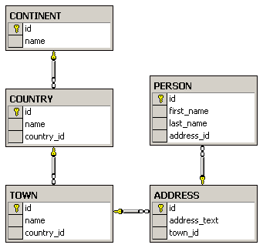
E/R Diagrams – example
The diagram is created with Microsoft SQL Server Enterprise Manager

Slide 136
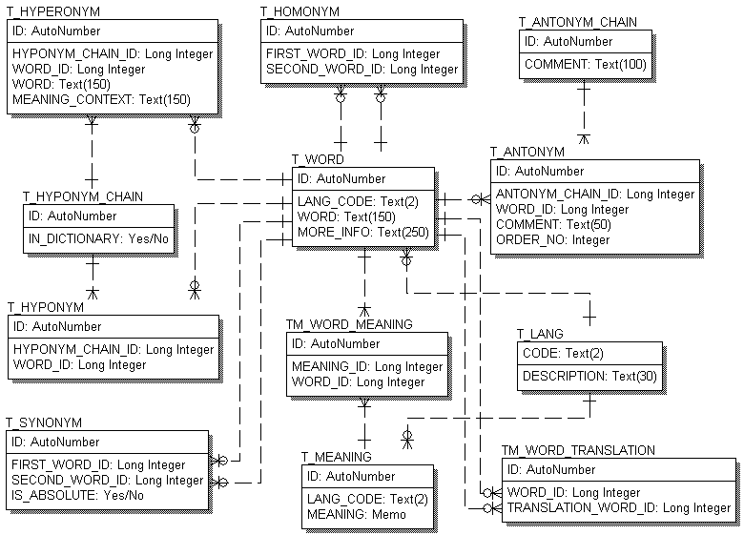
E/R Diagrams – example
The diagram is created with PLATINUM ERwin

Slide 137
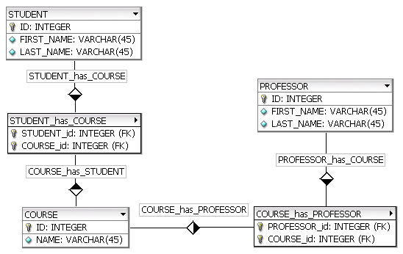
E/R Diagrams – example
The diagram is created with fabFORCE DB Designer

Slide 138
E/R Diagrams – example
The diagram is created with MS Visio

Slide 139
Tools for E/R Design
E/R diagrams are created with Data Modeling Tools:
SQL Server Enterprise Manager Oracle Designer
Microsoft Visio
Computer Associates ERwin
CASE Studio
IBM Rational Rose
theKompany Data Architect

Slide 140
Normalization
Normalization of the relational scheme removes repeating data
Non-normalized data contain many repetitions. For example:
Product | Producer | Price | Category | Shop | Town
Yoghurt | Mlexis LTD | 0.67 | food | store "Mente" | Sofia
bread "Dobrudja" | Bakery "Smoky" | 0.85 | food | store "Mente" | Sofia
beer "Zagorka" | Zagorka CO | 0.68 | soft drinks | stall "non-stop" | Varna
beer "Tuborg" | Shumen Drinks CO | 0.87 | soft drinks | stall "non-stop" | Varna

Slide 141
Normalization
1-st Normal Form
Data have table appearance
Fields in the rows are atomic (inseparable) values
There are no repetitions within a single row
A primary key is defined for each table
Book | ISBN (PK) | Author | AuthorEmail
.NET Framework | 3847028437 | Mr. Kiro | bai-kiro@abv.bg
Beginning SQL | 7234534450 | Santa | dedo@mraz.org

Slide 142
Normalization
2-nd Normal Form
Retains all requirements of 1-st Normal Form
There are no columns that depend on part of the primary key (if it consists of several columns)
The price depends on the book
E-mail depends on the author
book (PK) | Author (PK) | Price | AuthorEmail
.NET Framework | Mr. Kiro | 37.25 | bai-kiro@abv.bg
Beginning SQL | Santa | 19.95 | dedo@mraz.org

Slide 143
Normalization
3-rd Normal Form
Retains all requirements of 2-nd Normal Form
The only dependencies between columns are "a column depends on the PK"
Id | Product | ProducerId | Price | CategoryId | ShopId | TownId
1 | Yoghourt | 2 | 0.67 | 2 | 4 | 1
2 | bread "Dobrudja" | 3 | 0.85 | 2 | 4 | 1
3 | rakiya "Peshtera" | 6 | 6.38 | 5 | 2 | 1
4 | beer "Tuborg" | 4 | 0.87 | 4 | 1 | 3

Slide 144
Normalization
4-th Normal Form
Retains all requirements of 3-rd Normal Form
There is one column at most in each table that can have many possible values for a single key (multi-valued attribute)
One author can have many books
One author can have many articles
AuthorId | Book | Article
2 | .NET Programming | Regular Expressions in .NET
4 | Mastering J2EE | Best Practices in J2EE

Slide 145
Normalization
Example for a normalized scheme (in 4-th Normal Form):
Products
Id | Product | ProducerId | Price | CategoryId | ShopId | TownId
1 | Youghurt | 2 | 0.67 | 2 | 4 | 1
2 | bread "Dobrudja" | 3 | 0.55 | 2 | 4 | 1
3 | rackia "Pe6tera" | 6 | 4.38 | 5 | 2 | 1
4 | beer "Tuborg" | 4 | 0.67 | 4 | 1 | 3
Vendors
Categories
Stores
Towns
Id | Name
2 | "Mlex" ООД
4 | "Zagorka" АД
Id | Name
4 | beer
2 | food
Id | Name
1 | Billa
4 | METRO
Id | Name
1 | София
3 | Варна

Slide 146
Constraints
Constraints set data rules which cannot be broken
Primary key constraint
Primary key is unique for each record
Unique key constraint
Values in a column (or a group of columns) are unique

Slide 147
Constraints
Foreign key constraint
The value in a given column is a key from another table
Check constraint
Values in a certain column meet some condition
For example:
(hour>=0) AND (hour<=24)
name = upper(name)

Slide 148
Indexes
Indexes speed up searching of values in a certain column or group of columns
Used in big tables
Usually implemented as B-trees or hash tables
They can be outer indexes (outside the table) or built-in
Adding and deleting of records in indexed tables is slower

Slide 149
The SQL language
SQL (Structured Query Language)
Standardized declarative language for manipulation of relational databases
SQL-99 is into use
SQL supports:
Creating, altering, deleting tables and other objects in the database
Searching for, retrieving, inserting, changing and deleting records

Slide 150
The SQL language
SQL consists of:
DDL – Data Definition Language
CREATE, ALTER, DROP commands
DML – Data Manipulation Language
SELECT, INSERT, UPDATE, DELETE commands
Example for an SQL SELECT query:
SELECT Towns.Name, Countries.Name
FROM Towns, Countries
WHERE Towns.CountryId = Countries.Id

Slide 151
Stored Procedures
Procedures at database level (stored procedures)
Code executed on the very database server
Much faster than an outer code
Data is locally accessible
Can accept parameters
Can return result
single value
record set

Slide 152
Stored Procedures
Procedures at database level are written on a language extension of SQL
PL/SQL – in Oracle
T-SQL – in Microsoft SQL Server
A stored procedure in PL/SQL:
CREATE OR REPLACE PROCEDURE spInsertCountry(countryName varchar2) IS
BEGIN
INSERT INTO Countries(Name)
VALUES(countryName);
END;

Slide 153
Views
Views are named SQL SELECT queries which are used as tables
Facilitate writing of complex SQL queries
Also used to do fine security adjustments:
A certain user isn't given permissions on any of the tables
He is given permissions on some of the views only (a subset of data)

Slide 154
Views – Example
CREATE VIEW V_BGCompanies AS
SELECT
V_Companies.Id AS Id,
V_Companies.Company AS Company
FROM V_Companies INNER JOIN
(V_Towns INNER JOIN V_Countries ON
V_Towns.CountryId= V_Countries.Id)
ON V_Companies.TownId= V_Towns.Id
WHERE
V_Countries.Country = "Bulgaria";
Id | Company
1 | Mente LTD
3 | HardSoft CO
V_BGCompanies

Slide 155
Triggers
Triggers are database level procedures that activate when some event occurs, for instance:
When inserting a record
When changing a record
When deleting a record
Triggers can perform additional data processing
To change the newly added data
Support for logs and history

Slide 156
Triggers – Example
We have a table with company names :
A trigger that appends an "Ltd." at the end of the name of a new company:
CREATE TABLE Companies(
Id number NOT NULL,
Name varchar(50) NOT NULL)
CREATE OR REPLACE TRIGGER trg_Companies_INSERT
BEFORE INSERT ON Company
FOR EACH ROW
BEGIN
:NEW.Name := :NEW.Name || ' Ltd.';
END;

Slide 157
Transactions
Transactions are a sequence of actions (database operations) which are executed as a whole:
Either all of them execute successfully
Or none of the them
Example:
A bank transfer from one account into another (withdrawal + deposit)
If either the withdrawal or the deposit fails the whole operation is cancelled

Slide 158
A Transaction
Read
Write
Durable starting state
Write
Collection of reads and writes
Commit
Durable,
consistent,
ending state
Rollback
Notes:
Two possible outcomes of the transaction: It completes successfully (as agreed by unanimous vote of all its participants) or it fails and rolls back to the state before the transaction started
Durable: if the transaction didn’t occur, this state would persist
Analogy: A contract negotiation either results in a successful signed contract, or it fails. There is no intermediate. Similarly, once it is signed, it exists as a whole, it cannot be broken into pieces. It is also durable, lasting as long as specified within the contract.

Slide 159
Transactions Behavior
Transactions guarantee the consistency and the integrity of the database
All changes in a transaction are temporary
Changes become final when COMMIT is executed
At any time all changes can be canceled by ROLLBACK
All of the operations are executed as a whole, either all of them or none of them

Slide 160
Transactions: Examples
Withdraw $100
Transfer $100
Read current balance
New balance = current - 100
Write new balance
Dispense cash
Read savings
New savings = current - 100
Read checking
New checking = current + 100
Write savings
Write checking

Slide 161
Transactions Properties
Atomicity
Either execute everything or nothing
Consistency
The database remains consistent with logically correct data
Isolation
Different transactions are isolated from each other depending on the selected isolation level
Durability
If a transaction is confirmed, it cannot be lost

Slide 162
Transactions – Example
We have a table with bank accounts:
We use a transaction to transfer money from one account into another
CREATE TABLE Accounts(
Id int NOT NULL,
Balance decimal NOT NULL)
CREATE OR REPLACE PROCEDURE sp_Transfer_Funds(
fromAccount IN INT,
toAccount IN INT,
ammount IN NUMBER) IS
BEGIN

Slide 163
Transactions – Example
UPDATE Accounts set Balance = Balance - ammount
WHERE id = fromAccount;
IF SQL % ROWCOUNT = 0 THEN
ROLLBACK;
RAISE_APPLICATION_ERROR(-20001, 'Invalid src account!');
END IF;
UPDATE Accounts set Balance = Balance + ammount
WHERE id = to_account;
IF SQL % ROWCOUNT = 0 THEN
ROLLBACK;
RAISE_APPLICATION_ERROR(-20002, 'Invalid dst account!');
END IF;
COMMIT;
END;

Slide 164
Transactions and Isolation
Transactions can define different isolation levels
The stronger isolation ensures better consistency but works slower and the data is locked longer
Level of isolation | Dirty reads | Repeatable reads | Phantom reads
Read uncommitted | yes | yes | yes
Read committed | no | yes | yes
Repeatable read | no | no | yes
Serializable | no | no | no

Slide 165
Transactions Usage
When to use transactions?
Always when a business operation accesses more than one table
Example:
At the register of a store: we buy a cart of products
We either buy all of them and pay or we buy nothing and give no money
If any of the operations fails we cancel the transaction (the purchase)

Slide 166
Relational Database Modeling
Fundamental Concepts

Slide 167
Steps in DB design
Identification of the entities
Identification of the columns in the tables
Defining a primary key for each entity table
Identification of relationships
Multiplicity of relationships
Defining other constraints
Filling in test data

Slide 168
Identification of entities
Entity tables represent objects from the real world
Most often they are nouns in the text of the specification
For example:
Entities: Student, Course, Town
We need to develop a system that stores information for students, which are lectured in various courses. The courses are held in different towns. When registering a new student the following information is entered: name, faculty number, photo and date.

Slide 169
Identification of the Columns
Columns in the tables are characteristics of the entities
They have name and type
For example students have:
Name (text)
Faculty number (number)
Photo (binary block)
Date of enlistment (date)

Slide 170
Identification of the Columns
Columns are clarifications for the entities in the text of the specification, for example:
Students have the following characteristics:
Name, faculty number, photo, date of enlistment and a list of all courses
We need to develop a system that stores information for students, which are lectured in various courses. The courses are held in different towns. When registering a new student the following information is entered name, faculty number, photo and date of enlistment.

Slide 171
How to Choose a Primary Key?
Always define an additional column for the primary key
Don't use an existing column (for example SSN)
Must be a number (integer)
Must be declared as a primary key
Use identity in SQL Server
Put the primary key as a first column

Slide 172
Identification of relations
Relations are dependencies between the entities:
"Students are lectured in various courses" – a many to many relation
"Courses are held in towns" – a many to one relation
We need to develop a system that stores information for students, which are lectured in various courses. The courses are held in different towns. When registering a new student the following information is entered name, fac. number, photo and date of enlistment.

Slide 173
Data types in SQL Server 2005
Nullable and NOT NULL types
All types in SQL Server may or may not allow NULL values
Primary key columns
Define the primary key
Identity columns
Automatically increased values when a new row is added (autoincrement)
Used in combination with primary key

Slide 174
Database Modeling with SQL Server Management Studio
Database Creation

Slide 175
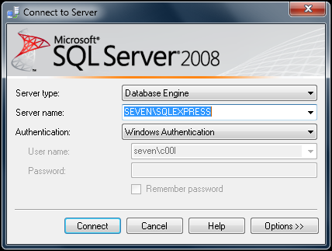
Connecting to SQL Server
When starting SSMSE a window pops up
Usually it is enough to just click the "Connect" button without changing anything

Slide 176
Connecting to SQL Server
If we want to connect to a server in the local network, we have to select the name of the server from the dropdown menu Server Name
Authentication – leave the default value: Windows Authentication

Slide 177
Working with Object Explorer
Object Explorer is the main tool to use when working with the database and its objects
Enables us:
To create a new database
To create objects in the database (tables, stored procedures, relations and others)
To change the properties of objects
To enter records into the tables

Slide 178
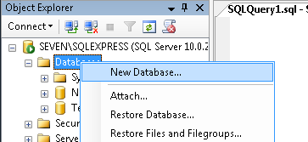
Creating a new database
In Object Explorer we go to the Databases level and choose "New Database" from the context menu

Slide 179
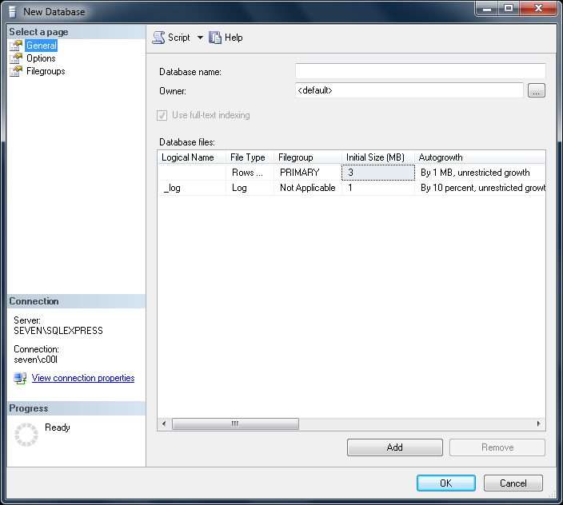
Creating a new database
In the "New Database" window we enter the name of the new database and click OK

Slide 180
Database Modeling with SQL Server Management Studio
Creating E/R diagrams

Slide 181
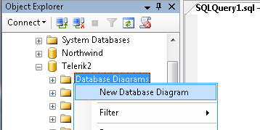
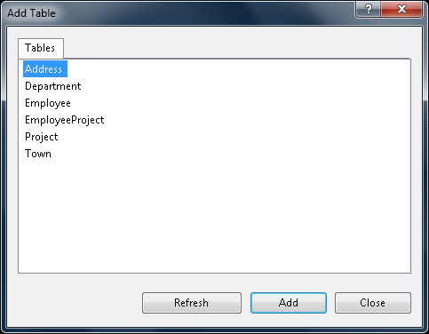
Creating an E/R diagram
In the "Database Diagrams" menu choose the "New Database Diagram" option
We can choose from the existing tables, which we want to add to the diagram

Slide 182
Database Modeling with SQL Server Management Studio
Creating Tables

Slide 183
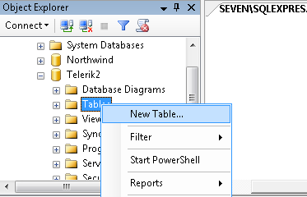
Creating Tables
If the database doesn't show immediately in Object Explorer we choose Refresh (F5)
We get a list of all the tables after we click on the “+” icon next to the name of our database and then next to Tables
To create a new table:

Slide 184
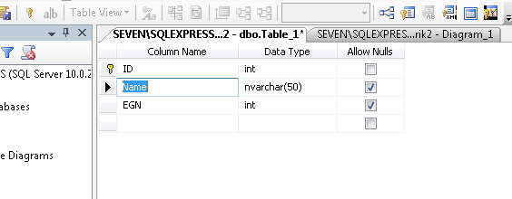
Creating Tables
To the right of Object Explorer a window is shown with the default name dbo.Table_1
We enter the name of the column here
We enter the data type of the column here
Whether NULL values can be entered

Slide 185
Creating Tables
Setting an Identity
Indicates that the values in a certain column are auto generated (for an int column)
These values cannot be changed
Identity Seed – the starting number from which the values in the column begin to increase.
Identity Increment – by how much each consecutive value is increased

Slide 186
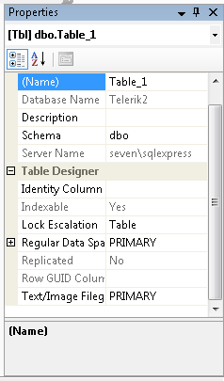
Creating Tables
It is a good practice to set the name of the table at this very moment in the Properties window
If it's not visible – View -> Properties Window or [F4]

Slide 187
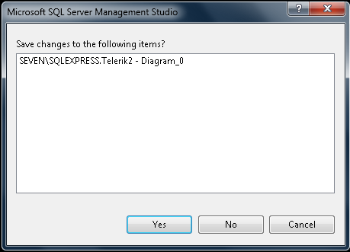
Creating Tables
When closing the window for the table, SSMSE asks whether to save the table
You can do it manually by choosing “Save Table” from the “File” menu or by pressing Ctrl + S

Slide 188
Database Modeling with SQL Server Management Studio
Creating Relations

Slide 189
Database Modeling with SQL Server Management Studio
Naming Conventions

Slide 190
Naming Conventions
Tables
Each word is capitalized (Pascal Case)
In English, plural
Examples: Users, AuctionGroups, Bids
Columns
In English, singular
Each word is capitalized (Pascal Case)
Avoid reserved words (e.g. key)
Examples: FirstName, OrderDate

Slide 191
Naming Conventions
Primary key
The name of the table + "Id"
For instance: in the Users table the PK column is called UserId
Foreign key
The name of the reference table + Id
For instance: in the Users table the foreign key column that references the Groups table has name GroupId

Slide 192
Naming Conventions
Relation names (constraints)
In English, Pascal Case
"FK_" + table1 + "_" + table2
For example: FK_Users_Groups
Index names
"IX_" + table + column
For example: IX_Users_UserName

Slide 193
Naming Conventions
Unique key constraints names
"UK_" + table + column
For instance: UK_Users_UserName
Views names
V_ + name
Example: V_BGCompanies
Stored procedures names
usp_ + name
Example: usp_InsertCustomer(@name)

Slide 194
Databases, SQL and MS SQL Server
Mihail Stoynov
Materna Bulgaria
mihail.stoynov.com

